Slide 1

Carbohydrates
Name-Kapil Sangameshwar Division-I Batch-2 Roll No.-32 PRN-12211559

Slide 2


INDEX
Definition
Diseases Caused Due to it
Symptoms of the diseases
Treatment
Various inventions for its early detection

Slide 3
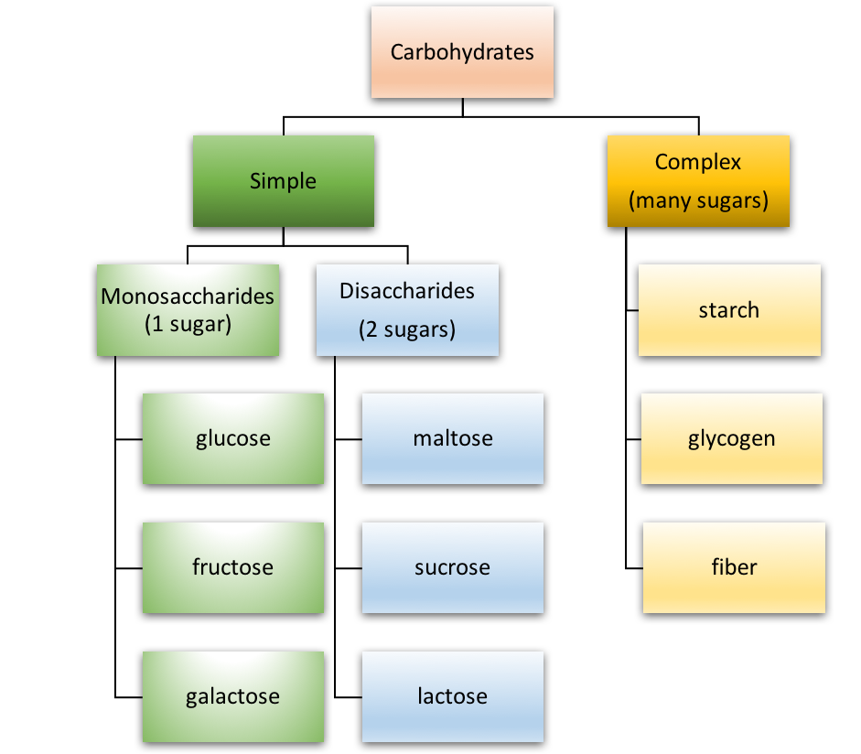
Definition
The definition of carbohydrate that is given in chemistry is that a naturally occurring compound, or a derivative of such a compound, with the general chemical formula C_{x}(H₂O)_{y}, made up of molecules of carbon (C), hydrogen (H), and oxygen (O).
But hey are basically sugar and its various compounds.
The Types of Carbohydrates are

Slide 4
Disease caused due to carbohydrates
Carbohydrate metabolism disorders -Metabolism is the process your body uses to make energy from the food you eat. Carbohydrate metabolism disorders are a group of metabolic disorders. Normally your enzymes break carbohydrate down into glucose. If you have one of these disorders, you may not have enough enzymes to break down the carbohydrates. Or the enzymes may not work properly. This causes a harmful amount of sugar to build up in your body.
The diseases caused due to a lack of carbohydrates in one’s body are –
Diabetes
Galactosemia
Ketosis
Hunter Syndrome
Hurler Syndrome
Mucopolysaccharidoses
Mucolipidosis
Pompe Disease

Slide 5
The diseases caused due to a lack of carbohydrates in one’s body are –
Weight Gain
Type 2 Diabetes
Cardiovascular Disease
Making Choices

Slide 6
Symptoms of the diseases
Carbohydrates metabolism disorder-Failure to gain weight satisfactorily, vomiting, hypoglycemia, liver dysfunction, and kidney defects.
Diabetes-Feeling more thirsty than usual, Urinating often, Losing weight without trying, Having blurry vision, Having slow-healing sores.
Galactosemia-Convulsions, Irritability, Lethargy, Poor feeding -- baby refuses to eat formula containing milk, Poor weight gain, Yellow skin and whites of the eyes (jaundice), Vomiting.
Hurler Syndrome- Abnormal bones in the spine, Inability to fully open the fingers (claw hand), Cloudy corneas, Deafness, Halted growth, Heart valve problems, Joint disease, including stiffness.
Mucolipidosis- delayed physical development, delayed cognitive development, delayed motor skills, skeletal abnormalities, abdominal or umbilical hernia, joint abnormalities distinct facial features (coarse facial features)
Pompe Disease-feeding problems, poor weight gain, trouble breathing, muscle weakness, enlarged heart, floppiness, and head lag. Many infants with Pompe disease also have enlarged tongues.
Cardiovascular Disease-Chest pain, chest tightness, chest pressure and chest discomfort (angina), Shortness of breath, Pain in the neck, jaw, throat, upper belly area or back, Pain, numbness, weakness or coldness in the legs or arms if the blood vessels in those body areas are narrowed.

Slide 7
Preventive Measures
Aromatherapy, hydrotherapy, homeopathy, acupuncture, juice therapy, osteopathy and Chinese traditional herbal medicine are used to treat diseases caused by deficiency of carbohydrates.
Consuming starchy vegetables and carbohydrate-rich fruits can prevent such diseases. Diseases caused by the lack of carbohydrates can be prevented with an intake of 50 to 100 grams of carbs daily.
A proper balance in the intake of carbohydrates and protein is essential.
Ketosis and other untoward effects of a very-low-carbohydrate diet can be prevented by the daily consumption of 50 to 100 grams of carbohydrate; however, obtaining at least half of the daily energy intake from carbohydrates is recommended.

Slide 8
inventions for its early detection
Carbohydrates are considered as one of the most important classes of biomarkers for cell types, disease states, protein functions, and developmental states.
Carbohydrate “binders” that can specifically recognize a carbohydrate biomarker can be used for developing novel types of site specific delivery methods and imaging agents.

Slide 9

Thank you

